Slide 1
Jquery

Slide 2
Introduction
jQuery is a lightweight, "write less, do more", JavaScript library.
The purpose of jQuery is to make it much easier to use JavaScript on your website.
jQuery takes a lot of common tasks that require many lines of JavaScript code to accomplish, and wraps them into methods that you can call with a single line of code.
jQuery also simplifies a lot of the complicated things from JavaScript, like AJAX calls and DOM manipulation.
The jQuery library contains the following features:
HTML/DOM manipulation
CSS manipulation
HTML event methods
Effects and animations
AJAX
Utilities

Slide 3
Why
There are lots of other JavaScript libraries out there, but jQuery is probably the most popular, and also the most extendable.
Many of the biggest companies on the Web use jQuery, such as:
Google
Microsoft
IBM
Netflix

Slide 4
Syntax
jQuery Syntax
The jQuery syntax is tailor-made for selecting HTML elements and performing some action on the element(s).
Basic syntax is: $(selector).action()
A $ sign to define/access jQuery
A (selector) to "query (or find)" HTML elements
A jQuery action() to be performed on the element(s)

Slide 5
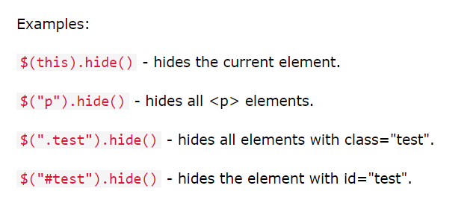

Slide 6
$(function(){
// jQuery methods go here...
});

Slide 7
What are Events?
All the different visitors' actions that a web page can respond to are called events.
An event represents the precise moment when something happens.
Examples:
moving a mouse over an element
selecting a radio button
clicking on an element

Slide 8
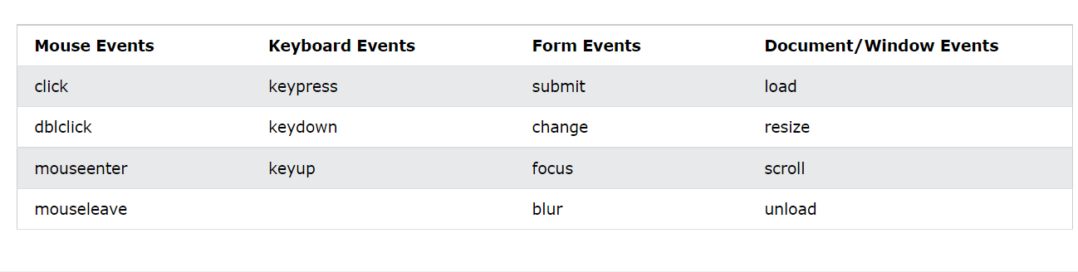

Slide 9
jQuery Method Chaining
jQuery Method Chaining
Until now we have been writing jQuery statements one at a time (one after the other).
However, there is a technique called chaining, that allows us to run multiple jQuery commands, one after the other, on the same element(s).
$("#p1").css("color", "red").slideUp(2000).slideDown(2000);

Slide 10
$("#p1").css("color", "red")
.slideUp(2000)
.slideDown(2000);

Slide 11
Show Hide
With jQuery, you can hide and show HTML elements with the hide() and show() methods:
$("#hide").click(function(){
$("p").hide();
});
$("#show").click(function(){
$("p").show();
});

Slide 12
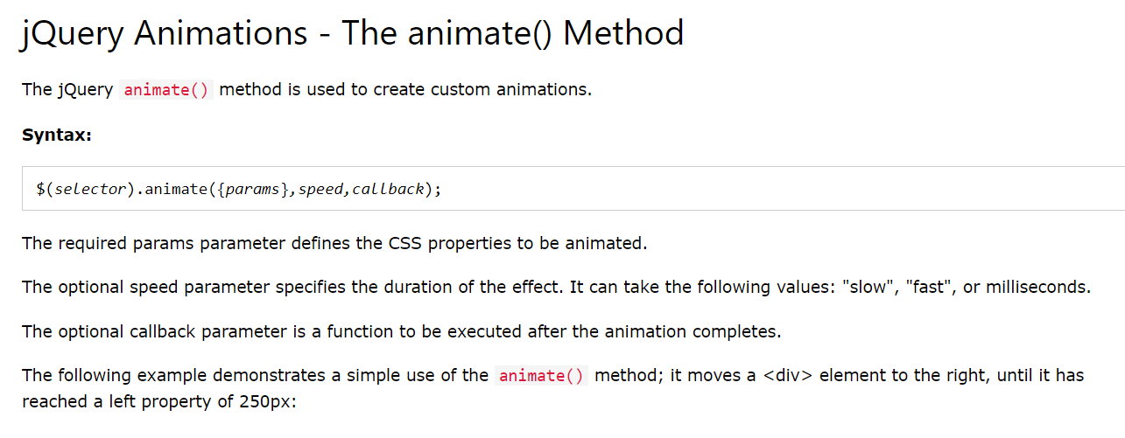
● Animate

Slide 13
$("button").click(function(){
$("div").animate({
left: '250px',
opacity: '0.5',
height: '150px',
width: '150px'
});
});

Slide 14
jQuery animate() - Using Relative Values
$("button").click(function(){
$("div").animate({
left: '250px',
height: '+=150px',
width: '+=150px'
});
});

Slide 15
jQuery animate() - Using Pre-defined Values
$("button").click(function(){
$("div").animate({
height: 'toggle'
});
});

Slide 16
jQuery animate() - Uses Queue Functionality
$("button").click(function(){
var div = $("div");
div.animate({height: '300px', opacity: '0.4'}, "slow");
div.animate({width: '300px', opacity: '0.8'}, "slow");
div.animate({height: '100px', opacity: '0.4'}, "slow");
div.animate({width: '100px', opacity: '0.8'}, "slow");
});

Slide 17
jQuery css() Method
css("propertyname");
$("p").css("background-color");

Slide 18
Set a CSS Property
css("propertyname","value");
$("p").css("background-color", "yellow");

Slide 19
Set Multiple CSS Properties
css({"propertyname":"value","propertyname":"value",...});
$("p").css({"background-color": "yellow", "font-size": "200%"});

